Slide 1
Deep Learning
Language Models

Slide 2
Course Contents
Deep Learning
Transformer
Finetuning
Agents
The Bigger Picture
Context Engineering
Instruction Tuning
LLMs

Slide 3
This Part: Deep Learning
NLP introduction
neural networks (example: image classification)
network training (with PyTorch)

Slide 4
Natural Language Processing (NLP)
field within AI and linguistics
aim: enable machines to understand and generate human language
language models: subfield of NLP
aim: model and understand language patterns (typically by learning to predict the next word in a sentence)
capabilities of large language models (LLM) cover most of NLP

Slide 5
NLP Tasks
part-of-speech tagging
named entity recognition
text classification
machine translation
summarization
question answering
text generation (chatbots)
code generation
…

Slide 6
Symbolic vs Neural NLP
symbolic NLP = rules and logic
uses hand-crafted rules, lexicons, and grammars
relies on linguistic knowledge and logic-based systems
neural NLP = data and learning
uses machine learning (especially deep learning)
learns patterns from large datasets without explicit rules

Slide 7
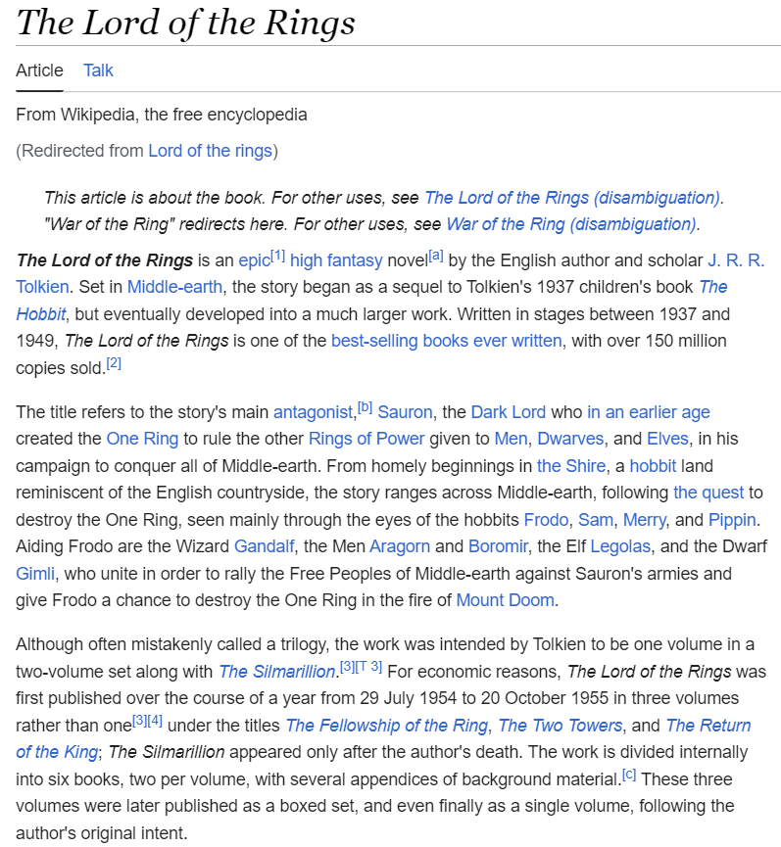
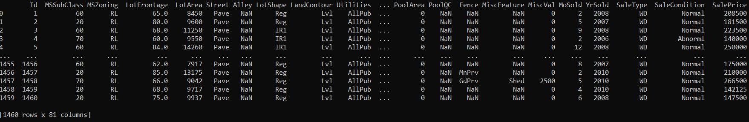
Learning from Data
ImageNet

Slide 8




MACHINE LEARNING
no supervision, but goal-based interaction with environment
training target available (labeled or past data)
data not labeled in any way
SUPERVISED
REINFORCEMENT LEARNING
UNSUPERVISED
CLASSIFICATION
ASSOCIATION
CLUSTERING
LEARN STATE OR ACTION VALUES
LEARN POLICY DIRECTLY
REGRESSION
DIMENSIONALITY REDUCTION
SELF-SUPERVISED
learning by teacher
(high-dimensional curve fitting)
learning by observation
(pattern recognition)
learning by trial-and-error
(sequential decision making)
unsupervised and reinforcement learning can both be cast as supervised-learning setup

Slide 9

Algorithmic Families of Supervised Learning
parametric models
nearest neighbors (local methods, instance-based learning):
non-parametric models
decision trees:
rule learning
linear regression
Day
neural networks: many linear models, nonlinear by means of activation functions
Weekday
Weekend
3
Promo
No
Yes
demand prediction
5
8
often used in ensemble methods
bagging: random forests
boosting: gradient boosting
kernel/support-vector machines: linear model (maximum-margin hyperplane) with kernel trick

Slide 10
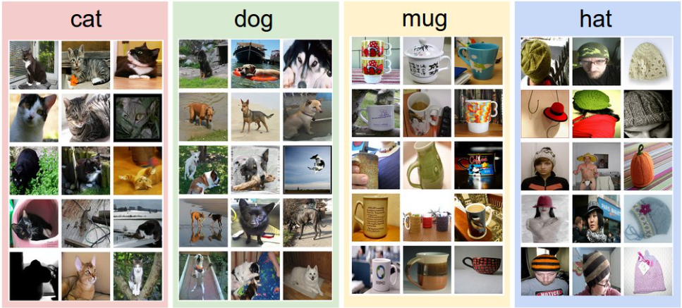
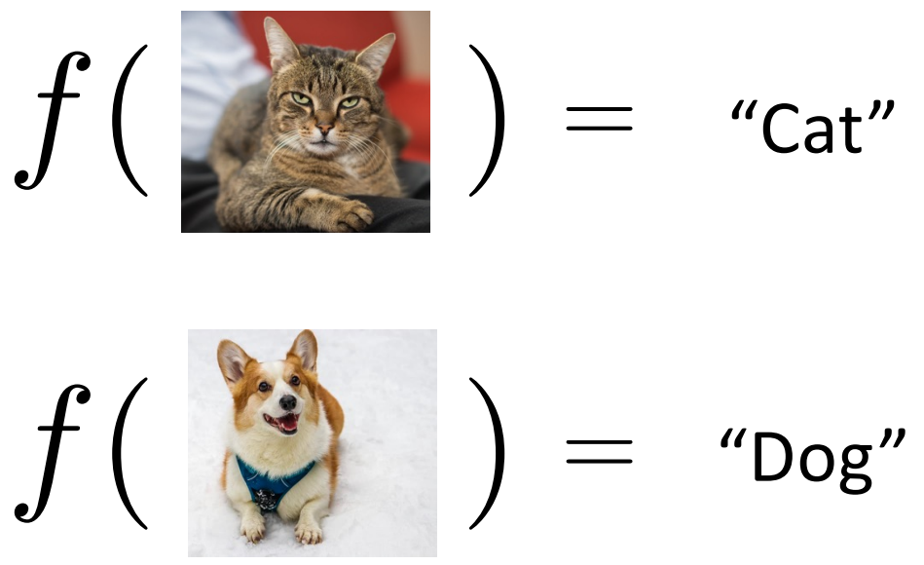
Example: Image Classification
training data:
test data with learned model:
labels:

Slide 11
Image Classification as Input-Output Mapping
complicated function
→ neural network

Slide 12

How Computers See Images
digital images: pixels und intensity
8-bit image

Slide 13


Neural Network as Nonlinear Function
digital image
intensity pixel $1$
intensity pixel $2$

Slide 14

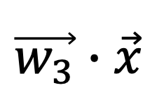
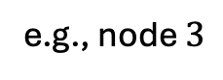
Neural Network as Nonlinear Function
parameters: learned from data
weights
(matrix)
Dog node
Cat node
e.g., node $3$
( )
probability for „cat“
(softmax instead of activation function)
linear transformation with nonlinear activation functions
$$\vec{w_{3}}∙\vec{x}$$

Slide 15
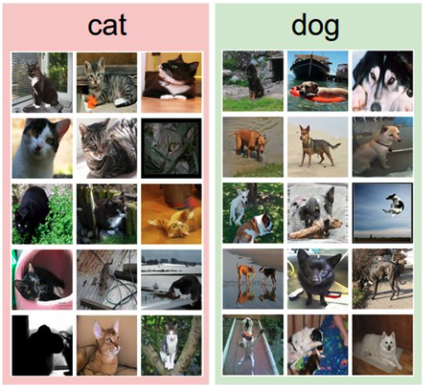
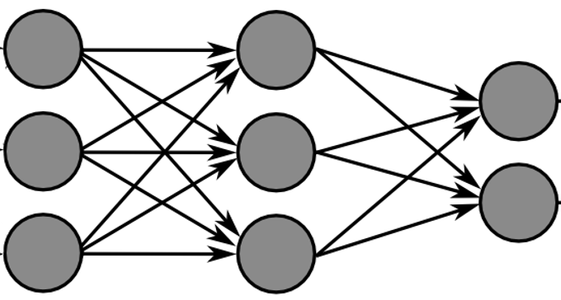
Training with Labeled Images
label:
forward pass
predictions

Slide 16
Training with Labeled Images
label:
forward pass
predictions
= ?
labels
error measurement
backpropagation
aim: minimization of errors

Slide 17

The Training Problem: Under- and Over-Fitting
example: polynomial fit
need to predict new samples (not in training data set): interpolation
degree of fitted polynomial

Slide 18
Training: Iterative Adjustment of Weights
for epoch in range(epochs):
for X, y in mini_batches:
pred = model(X)
cost = loss(pred, y)
cost.backward()
optimizer.step()
quantification of error (here: cross entropy)
chain rule to calculate gradient (direction) of cost function with respect to weights
one step in direction of steepest descent: (stochastic) gradient descent

Slide 19
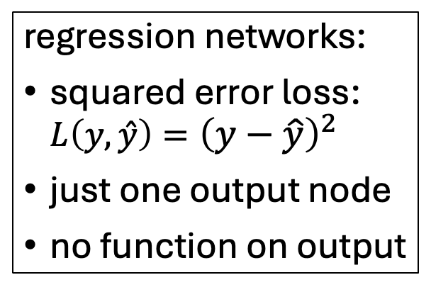
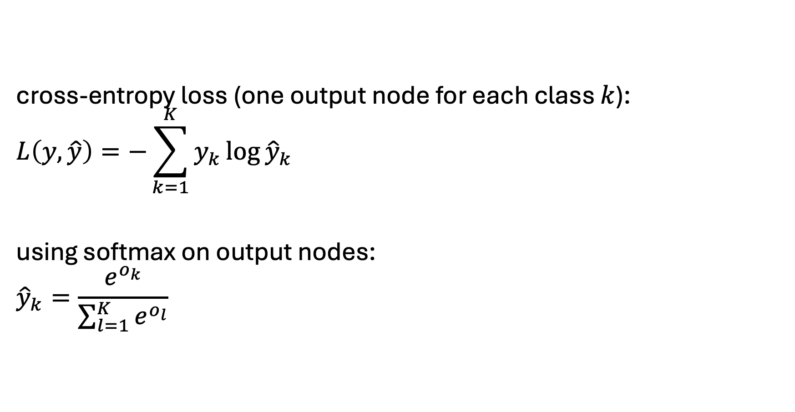
Classification Networks
cross-entropy loss (one output node for each class $k$):
$$L\left(y,\hat{y}\right)=−\sum_{k=1}^{K}{y_{k}\log{{\hat{y}}_{k}}}$$
using softmax on output nodes:
$${\hat{y}}_{k}=\frac{e^{o_{k}}}{\sum_{l=1}^{K}{e^{o_{l}}}}$$
regression networks:
squared error loss: ${L\left(y,\hat{y}\right)=\left(y−\hat{y}\right)}^{2}$
just one output node
no function on output

Slide 20

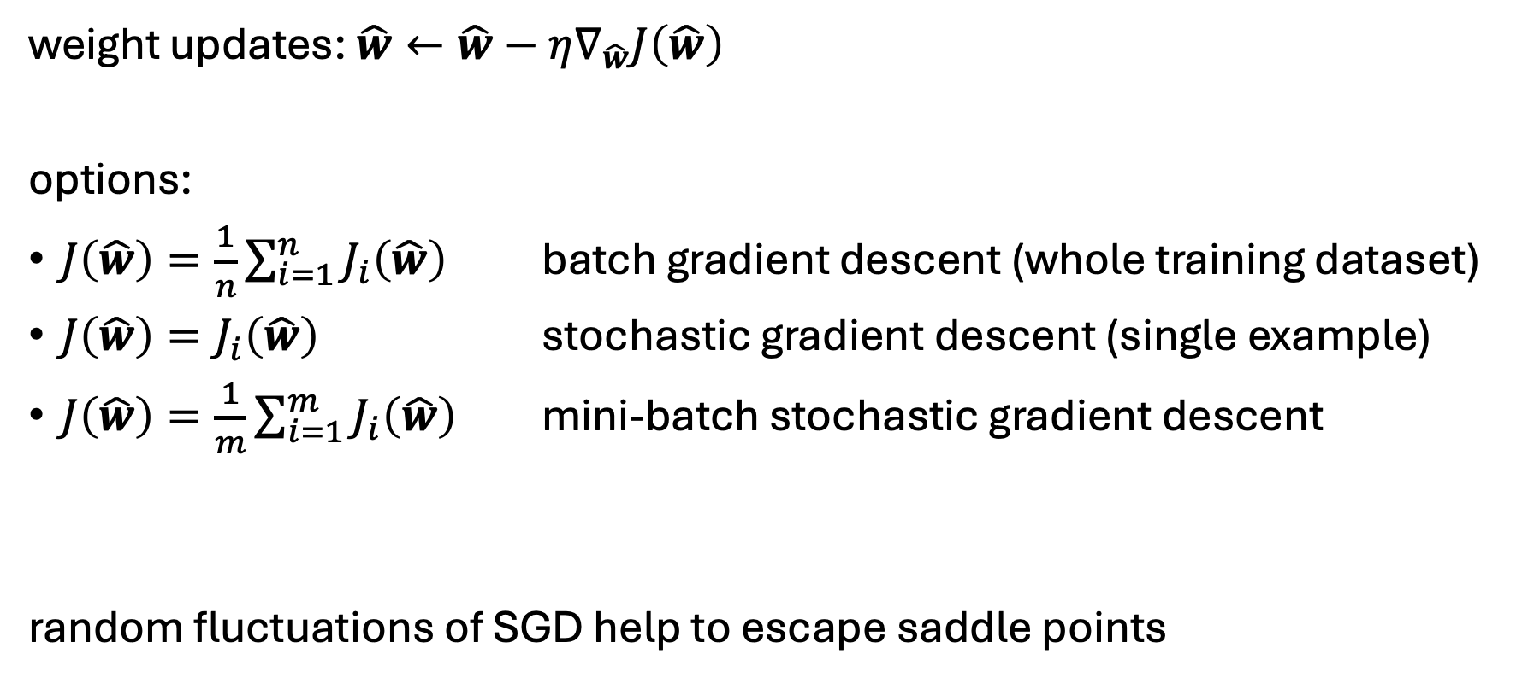
Stochastic Gradient Descent (SGD)
step size
cost function
weight updates: $\hat{w}←\hat{w}−η∇_{\hat{w}}J\left(\hat{w}\right)$
options:
$J\left(\hat{w}\right)=\frac{1}{n}\sum_{i=1}^{n}{J_{i}\left(\hat{w}\right)}$ batch gradient descent (whole training dataset)
$J\left(\hat{w}\right)=J_{i}\left(\hat{w}\right)$ stochastic gradient descent (single example)
$J\left(\hat{w}\right)=\frac{1}{m}\sum_{i=1}^{m}{J_{i}\left(\hat{w}\right)}$ mini-batch stochastic gradient descent
random fluctuations of SGD help to escape saddle points
all training examples
mini-batch size → hyperparamter: tradeoffs between runtime & memory, convergence & generalization

Slide 21
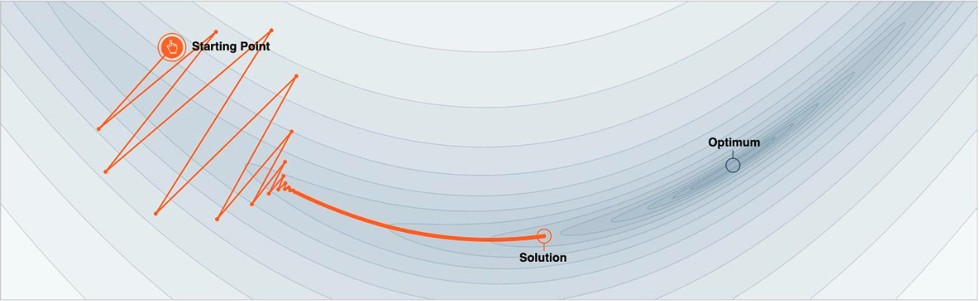
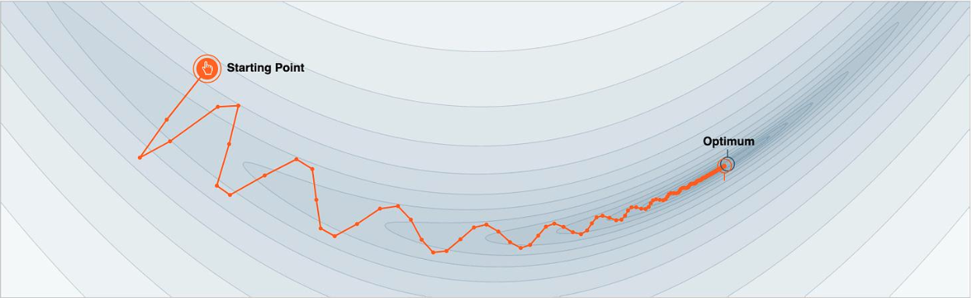
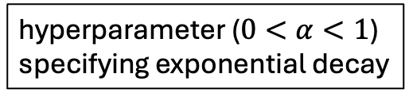
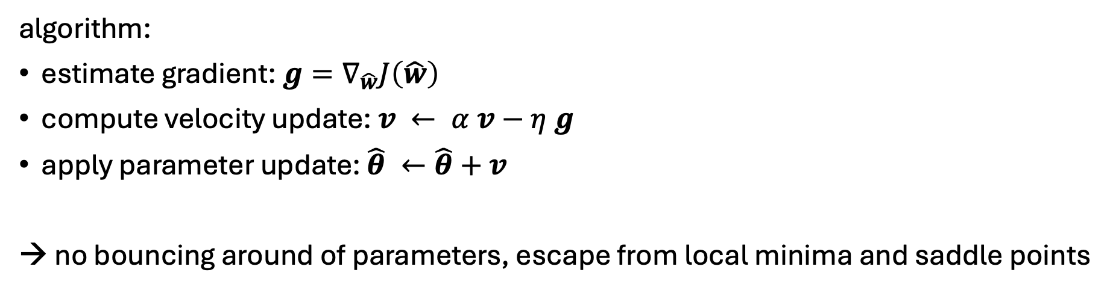
Gradient Descent with Momentum
hyperparameter ($0<α<1$) specifying exponential decay
algorithm:
estimate gradient: $g=∇_{\hat{w}}J\left(\hat{w}\right)$
compute velocity update: $v ← α v−η g$
apply parameter update: $\hat{θ} ←\hat{θ}+v$
→ no bouncing around of parameters, escape from local minima and saddle points

Slide 22


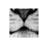
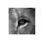
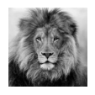




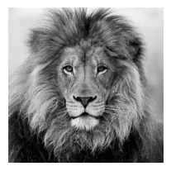
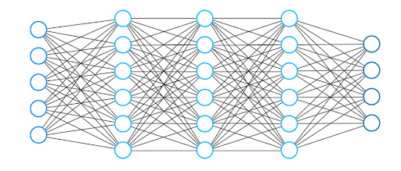
Hierarchical Representation
increasing abstraction
deep learning:
several hidden layers
elephant
dolphin
lion
eagle

Slide 23
Side Note: Inductive Bias for Vision
need for consideration of spatial structure
convolutional neural networks
vision transformer

Slide 24

How to Train Deep Neural Networks Effectively?
typical loss surface:
optimization and regularization difficult
local vs global minima, saddle points, easily overfitting
many hyperparameters to tune
but many methods to get it working in practice (despite partly patchy theoretical understanding)
optimization: activation and loss functions, weight initialization, adaptive learning rate (e.g., Adam), learning rate schedulers
explicit regularization: weight decay, dropout, data augmentation
implicit regularization: early stopping, batch/layer normalization, SGD
source

Slide 25
Next: Transformer
recent hype around LLMs
fully started with ChatGPT release end of 2022
technical backbone: transformer architecture
transformers also applicable to other areas, for example computer vision (as alternative to convolutional neural networks)

